Slide 1

CF-based Groceries Recommender systems Hasnain Gandhi (hg410) Mansi Borole (mb2208) Tarini Divgi (td508)

Slide 2
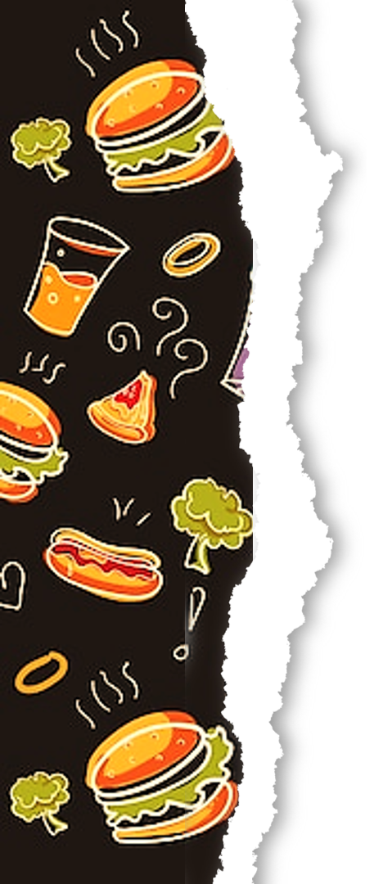
PROBLEM & DATASET​
How to find the best recommendations for the user based on their likes and dislikes
Dataset : Grocery and Gourmet Food + the metadata
# | Grocery and Gourmet Food​
No of reviews​ | 1143063​
No of unique reviewers​ | 127496​
No of unique products​ | 41280​
Notes:
As we know, recommendation systems play an important role in E-commerce business.
The correct items to show becomes an important use-case in this business and thus attracts lot of research in the domain.
We investigate the Gourmet and Grocery food section of the Amazon dataset.
The goal is to find the best recommendations for the user based on their likes and dislikes
The groceries and gourmet dataset contains user reviews, ratings, product IDs tagged to a unique reviewerID
And the metadata had all the unique products with their description, image, price and rank in the category
We merged the metadata set and the ratings dataset based on the product ID
We’re dealing with a very large dataset here, having more than a million reviews and 127k unique reviewers and around 41 thousand unique products.

Slide 3
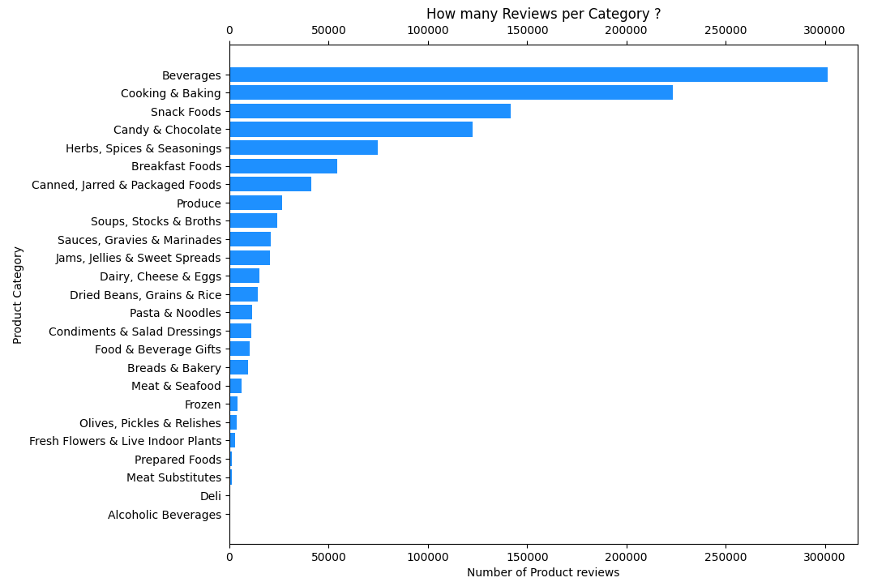
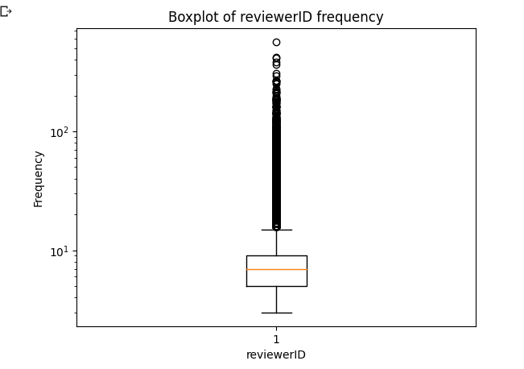
EDA
The amazon dataset comes with a lot of interesting features, we have used (ASIN, ReviewerID, Rating, Category, Title, Description)
Notes:
The first step in our analysis is Exploratory data analysis
We ask questions to the dataset that will help us understand it​
This will help us defining our implementation process​
The amazon dataset comes with a lot of interesting features, we have used (ASIN, ReviewerID, Rating, Category, Title, Description)
​ In the first chart here we are trying to understand what are the categories that the items belong to – and which categories are the most popular.
Next, we try to analyse the users, we see that on an average a reviewer makes around 9 reviews , but we see that there are many outliers , some users making more than 500 reviews.

Slide 4
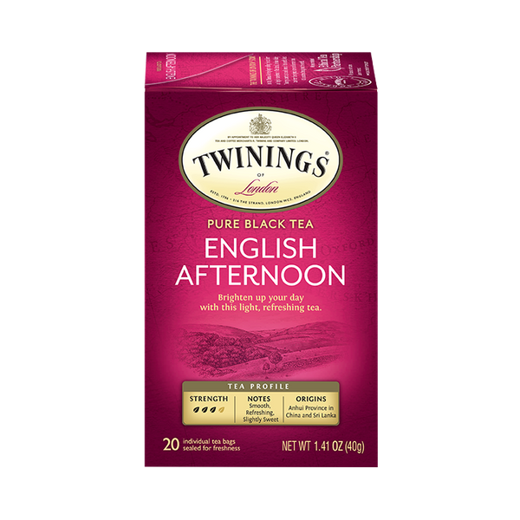
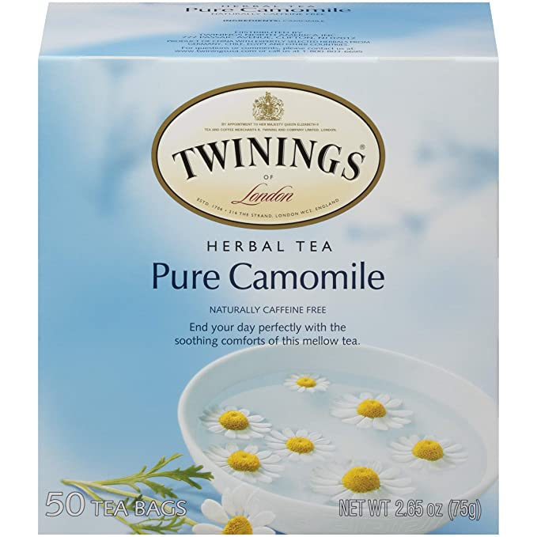


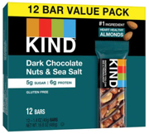

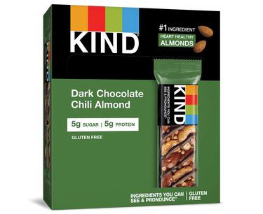
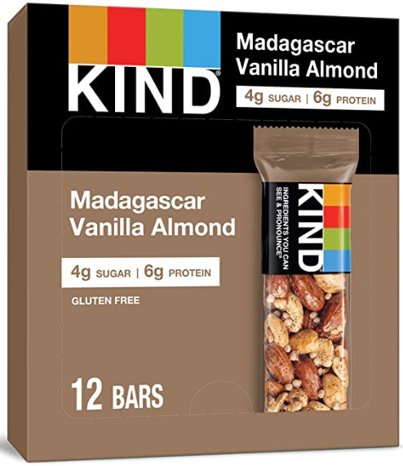

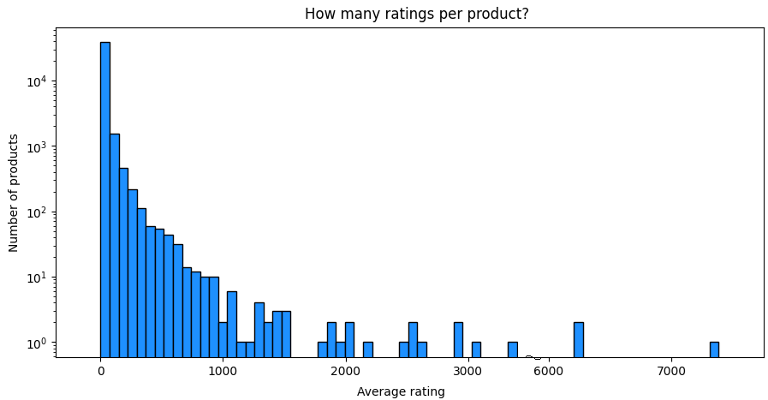
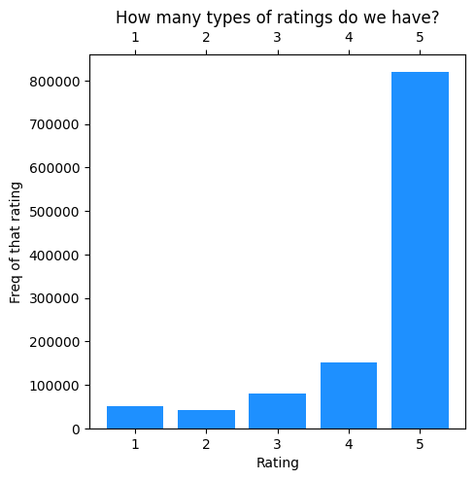
EDA
Average number of reviews per product 27.69
Average number of reviews per reviewer ~ 9 reviews
And 5* seems to be the most popular rating given
The User-item matrix has a sparsity of 0.794​
Notes:
Next we see how many ratings do we have per product and realize the majority of the items have around 27.69
Major challenge with this dataset is sparsity. We found that the User-item matrix has a sparsity of 0.794​
We have categorical ratings in this dataset – which are whole numbers. And 5* seems to be the most popular rating given
Next we list the top N reviwewed products
* Now I will hand it over to Hasnain -

Slide 5
Data pre-processing
Matrix Sparsity leads to data not fitting in the RAM as we have the matrix dimensions of 127496*41320. ​
Step 1: Drop columns which has no impact to the rating predictions: image, reviewername, summary etc.​
Step 2: Keep those rows for which the reviewer is verified. ​
Step 3: Remove the reviewers who have reviewed less than 20 products. ​
Step 4: Group by the reviewer such that each unique reviewer maps to the products they reviewed, and rating provided.​
Step 5: Use Train test split to split the processed data in the 80-20%.​
Notes:
Keep reviewers who are seasoned. Because those will be generalized and not biased. ​

Slide 6
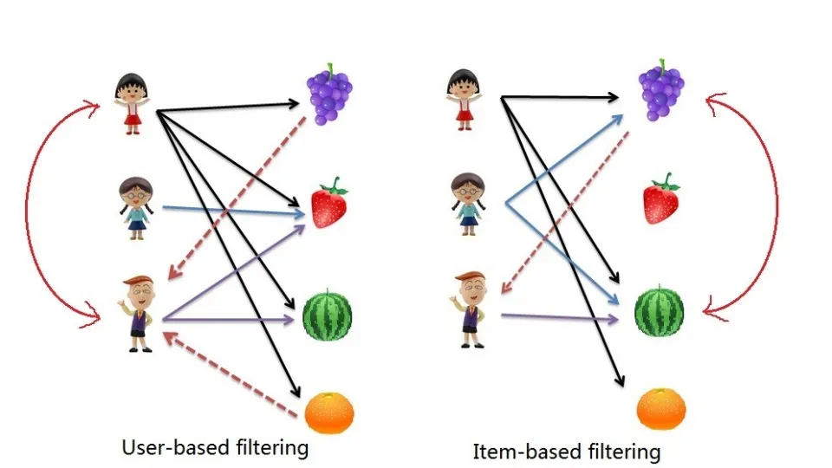
Rating Prediction Approach 1
K Nearest Neighbors:
Feature similarity to predict new data points.
User based CF:
Tries to identify users with the most similar 'Interaction Profile'.
Suggest items that are the most popular among these neighbors.
Item based CF:
Items like the ones the user already 'positively' interacted.
Suggest items such that most users interact with those items. Eg milk, eggs in grocery dataset.

Slide 7
Rating Prediction Approach 2​
A
Slope One (Weighted)–
Additional info used in Slope One –
Ratings by users who have rated some common item
Ratings of other items by the user
Consider the query (C,k) -
Diff(k,j) = ((4-3)+(4-2))/2 = 1.5
Diff(k,i) = (2-4)/1 = -2
Predicted Rating =
(2*(2+1.5)+1*(4-2))/(2+1) = 3
5 3 4
A
B
4 ? 2
B
C
4 2 ?
C
i
j
k

Slide 8
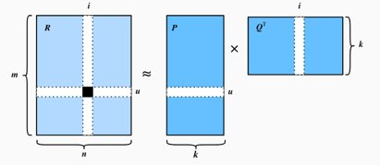
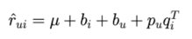
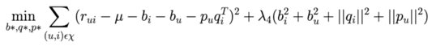
Rating Prediction Approach 3​
Latent Factor Model - SVD –
Users and items are mapped to latent factor space
q_{i} – item-concept mapping for item i
p_{u} – user-concept mapping for user u
Funk SVD was used for minimization using learning rate = 0.009, and
regularization constant = 0.05

Slide 9
Item Recommendation
Step 1: Create prediction dataframe from the algorithm. Consists of reviewerid, productid and predicted rating value.
Step 2: Create a nested list such that for each reviewer we have the tuple (productid, predicted_rating).
Step 3: Sort the list such that we get the top 10 values for each user.

Slide 10
Metrics
Metrics​ | RMSE​ | MAE​ | Precision​ | Recall | F1 Score​ | NDCG
KNN Basic​ | 0.9765​ | 0.6351​ | 0.6443 ​ | 0.0987 | 0.1711​ | 0.3203​
KNN with Means​ | 0.9745​ | 0.6325​ | 0.7076 | 0.1060 | 0.1844​ | 0.3318​
KNN Baseline​ | 0.9808​ | 0.6460​ | 0.7589​ | 0.1196 | 0.2066​ | 0.3256​
Slope One​ | 0.9929 ​ | 0.6404 | 0.7784​ | 0.1029 | 0.1819​ | 0.3403​
SVD Baseline​ | 0.8558​ | 0.6123 | 0.7723​ | 0.1016 | 0.1796​ | 0.3140​

Slide 11
Future Work
Incorporate more features – price ranges, seasonality of products,
Effect of NLP, including implicit feedback.
Fairness and Unbiases of Recommender Systems (Providing users with feedback on their recommendations. This can be done by showing users the factors that contributed to a particular recommendation, or by allowing users to flag recommendations that they do not think are relevant)
Privacy Protection for Recommender Systems - (we can collect only the data that is necessary, also giving users control over their data and anonymization of data)

Slide 12


Thank you

